Slide 1
Bayesian Decision Theory Case Studies

Slide 2
Case Study I
A. Madabhushi and J. Aggarwal, A bayesian approach to human activity recognition, 2nd International Workshop on Visual Surveillance, pp. 25-30, June 1999.

Slide 3
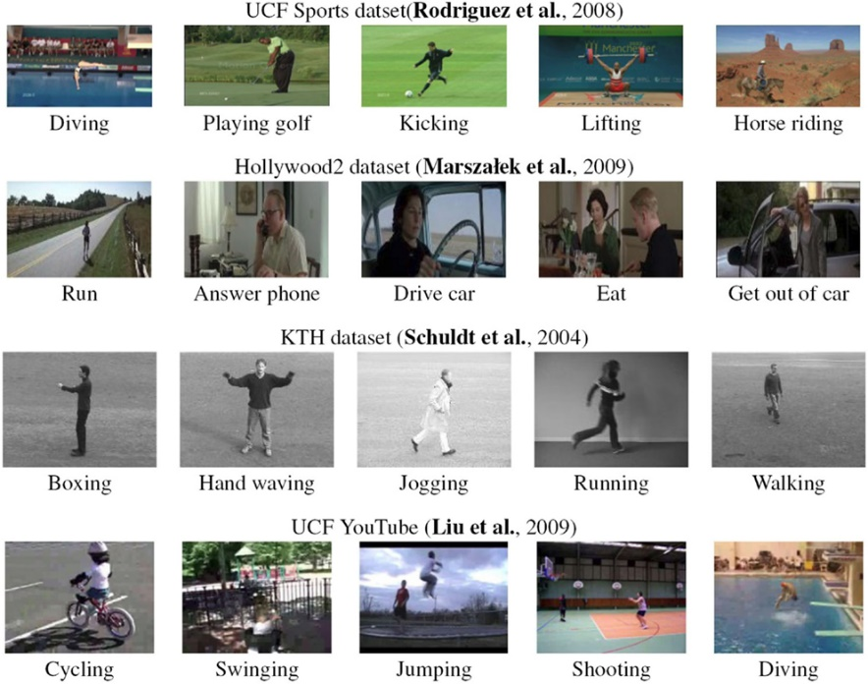
Human activity recognition
Recognize human actions using visual information.
Useful for monitoring of human activity in department stores, airports, high-security buildings etc.
Building systems that can recognize any type of action is a difficult and challenging problem.

Slide 4
Goal (this paper)
Build a system that is capable of recognizing the following 10 (ten) actions, from a frontal or lateral view:
sitting down
standing up
bending down
getting up
hugging
squatting
rising from a squatting position
bending sideways
falling backward
walking

Slide 5
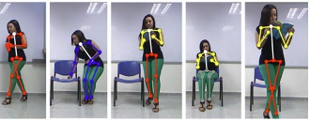
Motivation
People sit, stand, walk, bend down, and get up in a more or less similar fashion.
Human actions can be recognized by tracking various body parts.

Slide 6
Proposed Approach
Use head motion trajectory
The head of a person moves in a characteristic fashion during these actions.
Recognition is formulated as Bayesian classification using the movement of the head over consecutive frames.

Slide 7
Strengths and Weaknesses
Strengths
The system can recognize actions where the gait of the subject in the test sequence differs considerably from the training sequences.
Also, it can recognize actions for people of varying physical appearance (i.e., tall, short, fat, thin etc.).
Limitations
Only actions in the frontal or lateral view can be recognized successfully by this system.
Non-realistic assumptions.

Slide 8
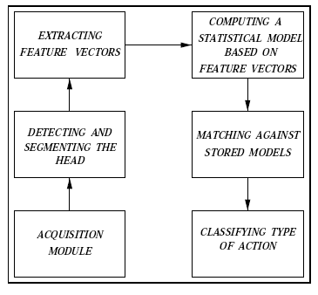
Main Steps
input
output

Slide 9


Action Representation
Estimate the centroid of the head in each frame:
Find the absolute differences in successive frames:
,
|
|
|
|

Slide 10
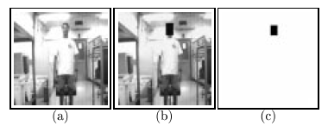
Head Detection and Tracking
Accurate head detection and tracking are crucial.
In this paper, the centroid of the head was tracked manually from frame to frame.

Slide 11



Bayesian Formulation
In Bayesian statistics, the posterior probability of a random event or an uncertain proposition is the conditional probability that is assigned after the relevant evidence or background is taken into account.
Given an input sequence, the posterior probabilities are computed for each action (2 x 10 = 20) using the Bayes rule:

Slide 12
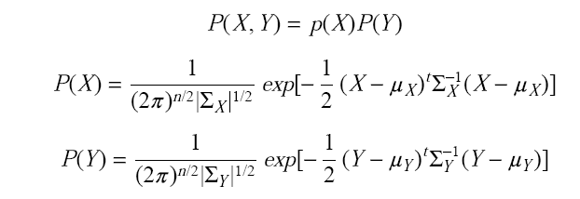
Probability Density Estimation
Feature vectors X and Y are assumed to be independent (valid?), following a multi-variate Gaussian distribution:

Slide 13
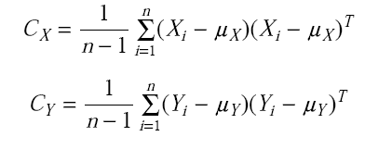
Probability Density Estimation (cont’d)
The sample covariance matrices are used to estimate Σ_{X} and Σ_{Y} :
Two distributions are estimated for each action, corresponding to the frontal and lateral views.
Σ_{X}
Σ_{Y}

Slide 14

Action Classification
Given an input sequence, the posterior probability is computed for each action.
The unknown action is classified based on the most likely action:

Slide 15
Discriminating Similar Actions
In some actions, the head moves in a similar fashion, making it difficult to distinguish these actions from one another; i.e.,:
(1) The head moves downward without much sideward deviation in the following actions:
* squatting
* sitting down
* bending down

Slide 16
Discriminating Similar Actions (cont’d)
(2) The head moves upward without much sideward deviation in the following actions:
* standing up
* rising
* getting up
Several heuristics are used to distinguish among similar actions:
e.g., when bending down, the head goes much lower than when sitting down.

Slide 17
Training
A fixed CCD camera working at 2 frames per second was used to obtain the training data.
People of diverse physical appearance were used to model the actions.
Subjects were asked to perform the actions at a comfortable pace.
38 sequences were taken of each person performing all the actions in both the frontal and lateral views.

Slide 18
Training (cont’d)
Assumptions
It was found that each action can be completed within 10 frames.
Only the first 10 frames from each sequence were used for training (i.e., 5 seconds)

Slide 19
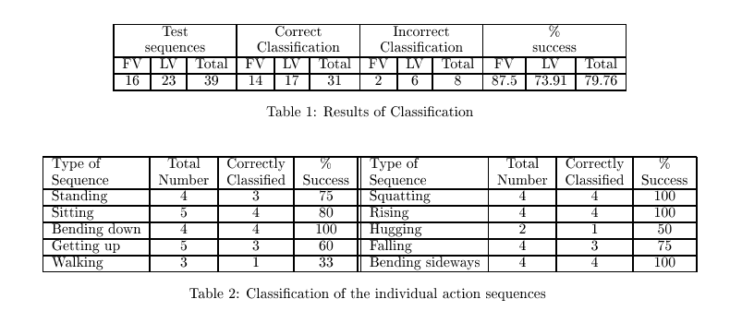
Testing
39 sequences were used for testing
Only the first 10 frames from each sequence were used for testing (i.e., 5 seconds)
Of the 8 sequences classified incorrectly, 6 were assigned to the correct action but to the wrong view.

Slide 20
Practical Issues
How would you find the first and last frames of an action in general (segmentation)?
Is the system robust to recognizing an action performed at various speeds or from incomplete sequences (i.e., assuming that several frames are missing)?
Current system is unable to recognize actions from different viewpoints.

Slide 21
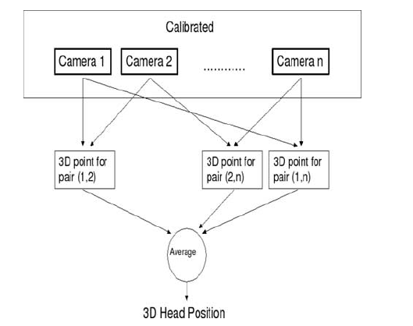
Extension
J. Usabiaga, G. Bebis, A. Erol, Mircea Nicolescu, and Monica Nicolescu, "Recognizing Simple Human Actions Using 3D Head Trajectories", Computational Intelligence , vol. 23, no. 4, pp. 484-496, 2007.

Slide 22
Case Study II

Slide 23
Overview
Build a system that can detect and track a person’s face while the person moves freely in some environment.
Useful in a number of applications such as video conference, visual surveillance, face recognition, etc.
Key Idea: Use a skin color model to detect faces in an image.

Slide 24
Why Using Skin Color?
Traditional systems for face detection use template matching or facial features.
Not very robust and time consuming.
Using skin-color leads to faster and more robust face detection.

Slide 25
Main Steps
(1) Detect human faces in various images using a skin-color model.
(2) Track face of interest by controlling the camera position and zoom.
(3) Adapt skin-color model parameters based on individual appearance and lighting conditions.

Slide 26
Main System Components
A probabilistic model to characterize skin-color distributions of human faces.
A motion model to estimate human motion and to predict search window in the next frame.
A camera model to predict camera motion (i.e., camera’s response was much slower than frame rate).

Slide 27
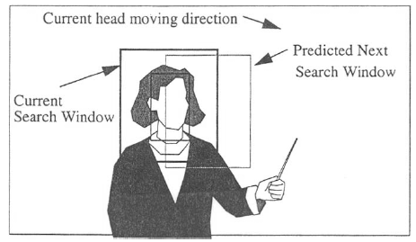
Search Window

Slide 28
Challenges Modeling Skin Color
Skin color is influenced by many factors:
Skin color varies from person to person.
Skin color can be affected by ambient light, motion etc.
Different cameras produce significantly different color values (i.e., even for the same person under the same lighting conditions).

Slide 29

RGB vs Chromatic Color Space
RGB is not the best color representation for characterizing skin-color (i.e., it represents not only color but also brightness).
Represent skin-color in the chromatic space which is defined as follows:
(note: the normalized blue value is redundant since r + g + b = 1)

Slide 30
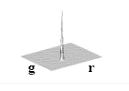
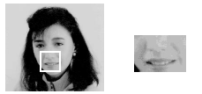
Skin-Color Clustering
Skin colors do not fall randomly in the chromatic color space but actually form clusters.

Slide 31
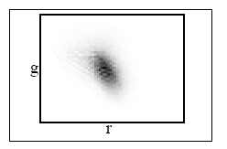
Skin-Color Clustering (cont’d)
Skin-colors of different people are also clustered in chromatic color space
i.e., they differ more in brightness than in color.
(skin-color distribution of 40 people - different races)

Slide 32
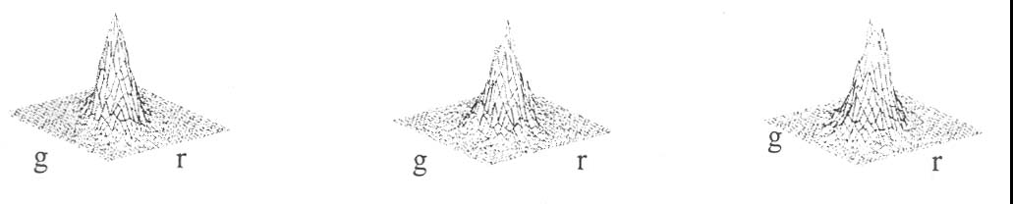
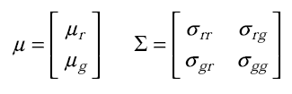
Skin-Color Modeling
Experiments (i.e., under different lighting conditions and persons) have shown that the skin-color distribution has a rather regular shape.
Idea: represent skin-color distribution using a 2D Gaussian distribution with mean μ and covariance Σ:
Examples:

Slide 33
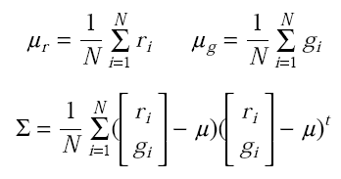
Parameter Estimation
Collect skin-color regions from a set of face images.
Estimate the mean and covariance using the sample mean and sample covariance:

Slide 34
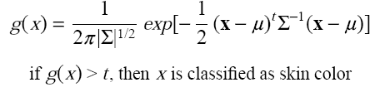
Face detection using skin-color
Each pixel x in the input image is converted into the chromatic color space and compared with the distribution of the skin-color model.

Slide 35
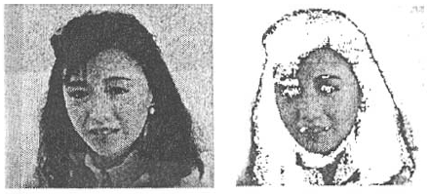
Example
Note: in general, we can model the non-skin-color distribution too
and compute the max posterior probability using the Bayes rule
(i.e., two-class classification: skin-color vs non-skin-color)

Slide 36
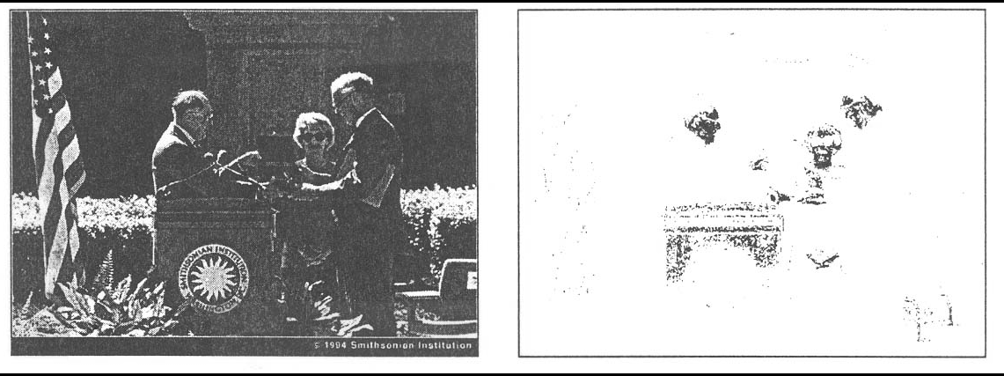
Dealing with skin-color-like objects
It is impossible in general to detect only faces simply from the result of color matching.
e.g., background may contain skin colors

Slide 37
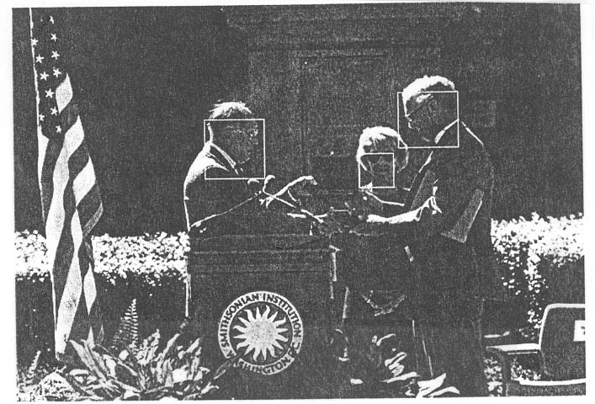
Dealing with skin-color-like objects (cont’d)
Additional information should be used for rejecting false positives (e.g., geometric features, motion etc.)

Slide 38
Skin-color model adaptation
If a person is moving, the apparent skin colors change as the person’s position relative to the camera or light changes.
Idea: adapt model parameters (μ,Σ) to handle these changes.

Slide 39
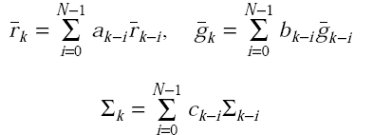
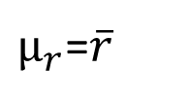
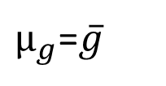
Skin-color model adaptation (cont’d)
The weighting factors a_{i}, b_{i}, c_{i} determine how much past parameters will influence current parameters.
N determines how long the past parameters will influence the current parameters.

Slide 40
System initialization
Automatic mode
A general skin-color model is used to identify skin-color regions.
Motion and shape information is used to reject non-face regions.
The largest face region is selected (i.e., face closest to the camera).
Skin-color model is adapted to the face being tracked.

Slide 41
System initialization (cont’d)
Interactive mode
The user selects a point on the face of interest using the mouse.
The tracker searches around the point to find the face using a general skin-color model.
Skin-color model is adapted to the face being tracked.

Slide 42
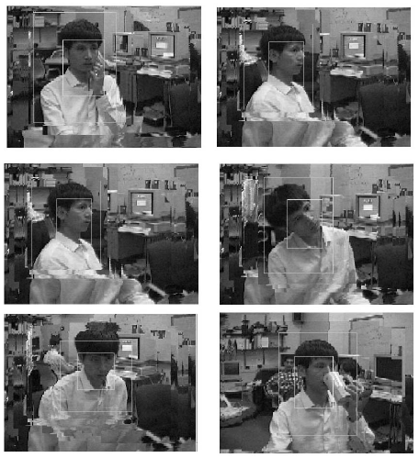
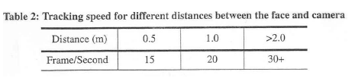
Detection Results

